Slide 1
Audio Setup
Computer (VoIP) Audio
Phone Audio
1
Click on the Audio Setup Wizard button in the Audio & Video Panel.
1
Click on the blue telephone icon in the Audio & Video Panel.
2
2
Click to talk.
Dial the telephone number and PIN provided.
3
A icon by your name means your mic is on.

Slide 2
Need Help with Today’s Program?
Help Desk: 800-442-4614
Phone in to today’s program
Toll: 630-424-2356
Toll Free: 855-947-8255
Passcode: 6774570#
Program will be archived:
www.foodsafety.wisc.edu

Slide 3
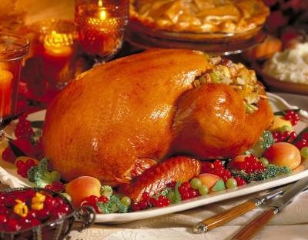
Food Safety & the Thanksgiving Meal
Lunch & Learn
12 noon to 1 pm
November 5, 2013

Slide 4
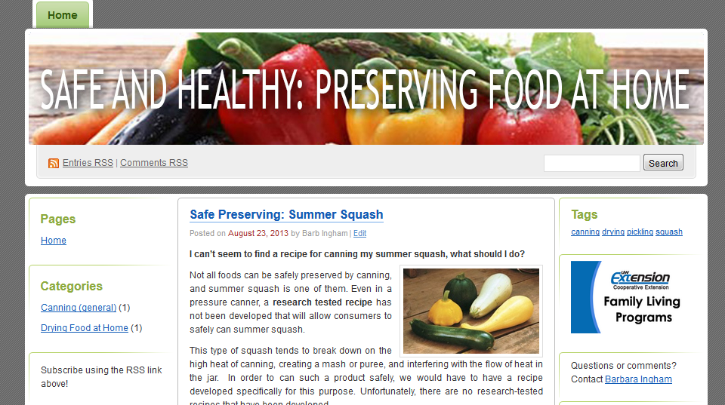
Safe & Healthy: Preserving Food at Home
There’s a new blog to help you stay up-to-date on food safety and food preservation information all year long. Subscribe via email to stay informed.
http://fyi.uwex.edu/safepreserving/

Slide 5
Plan Ahead for a Successful Thanksgiving
Make a guest list: decide how many you will feed, plan your menu and gather your recipes.
Clear the fridge: plan pre-holiday meals to use foods that are taking up valuable room in the freezer or refrigerator.
Start shopping: check your pantry and make a shopping list of necessary ingredients; buy foods on sale before the ‘big day’.
Get the thermometers ready: buy a food thermometer if you don’t already have one. A thermometer is key in producing a safe, high quality meal.

Slide 6
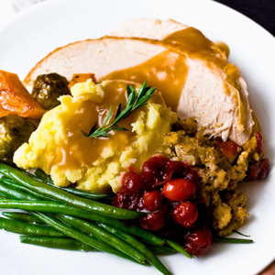
Fresh or Frozen
Frozen turkey is available year-round, but readily available around Thanksgiving
Fresh turkey should be purchased no more than 1-2 days before your holiday meal
Do not buy a pre-stuffed fresh turkey.
Estimate one pound of turkey for each person on your guest list
One pound/person is enough for ample portions and leftovers
A larger turkey, over 16 pounds, has more meat per pound and will feed 2 people per pound!
If purchasing a pre-stuffed frozen turkey,
purchase 1¼ pounds per person.
A turkey frozen since last year can still be safely prepared.

Slide 7
Thawing a Frozen Turkey
In the refrigerator. Place frozen bird in original wrapper on a tray in the refrigerator (40°F or lower). Allow ~1 day for each 4-5 pounds of turkey to thaw. Once thawed, store in refrigerator for up to 2 days.
In cold water. Submerge the wrapped turkey in cold water (50°F); change the water every 30 minutes. Allow 30 minutes defrosting time per pound. Cook immediately.
The microwave may be used – see instructions.
Size of Turkey | Thawing in Refrig. | Thawing in Water
4 to 12 pounds | 1 to 3 days | 2 to 6 hours
12 to 16 pounds | 3 to 4 days | 6 to 8 hours
16 to 20 pounds | 4 to 5 days | 8 to 10 hours
20 to 24 pounds | 5 to 6 days | 10 to 12 hours

Slide 8
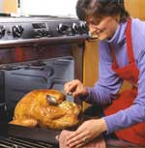
Roasting a Turkey
If you choose to stuff, stuff loosely.
Add stuffing immediately before roasting. Stuffing should be moist, never dry.
Roast in an oven set to 325°F or higher.
Do not place turkey in a hot oven, and then turn the oven off.
Do not roast in an oven set lower than 325°F.
Size of Turkey | Cooking Time at 325°F*
8 to 12 pounds | 2¾ to 3 hours
12 to 14 pounds | 3 to 3¾ hours
14 to 18 pounds | 3¾ to 4¼ hours
18 to 20 pounds | 4¼ to 4½ hours
20 to 24 pounds | 4½ to 5 hours
*Stuffed turkey will take 15-30 minutes longer (total) to cook.
Turkey or stuffing must reach 165°F to ensure safety.

Slide 9
Cooking a Frozen Turkey
Sometimes the easiest way to cook a turkey is from the ‘frozen state.’
www.foodsafety.wisc.edu/assets/pdf_Files/Cooking_Turkey_From_the_Frozen_State_Nov11.pdf
Set oven to 325°F.
Remove wrapping from turkey and put on a rack in a roasting pan.
Roast turkey. Checking temperature after 2-2½ hours. Turn bird, if desired. Remove giblet bag.
After 3½ hours, add seasoning if desired and begin basting.
A small turkey (12-13 pounds) requires ~5 hours if cooked from the frozen state. A larger turkey (15-20 pounds) requires ~7 hours to cook.
➔ Do NOT use with a stuffed turkey. Turkey must reach 165°F to be safe.

Slide 10
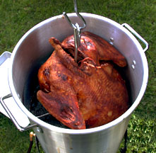
Brining or Frying a Turkey
Lean meats such as turkey can benefit from brining, usually in salt-water, prior to cooking.
Brined meats takes up liquid during soaking and retain more moisture when cooked.
Brine whole turkey in a mix of 2 cups salt* to 1 gallon of water. Brine for 12 to 24 hours. [Measurement for kosher salt, if using table salt decrease to 1 cup.]
A small turkey (12 pounds or less) can be fried.
Determine amount of oil needed. Turkey should be covered by 1-2 inches.
Heat oil to 350°F. Allow 3-5 minutes per pound to reach 165°F.
Note: many frozen turkey are pumped or pre-brined and should not be brined at home.

Slide 11
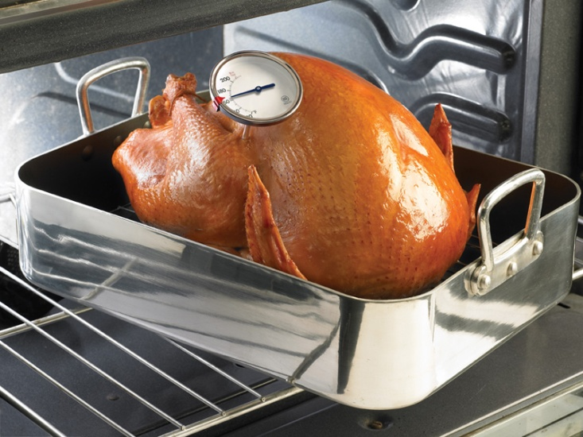
Using a Meat Thermometer
To ensure safety, turkey must be cooked to 165°F (or higher).
A thermometer is the only way to accurately determine temperature and to avoid over-cooking meat.
Place the thermometer in the thickest part of the turkey, in the thigh area. Do not allow the thermometer
to touch bone or fat.

Slide 12
FAQs
Can I use an electric roaster to cook a turkey? Yes! An electric roaster can easily cook a turkey. Cook on a rack in a roaster set to 325°F or higher. Don’t use a slow cooker to prepare a whole turkey or frozen parts .
Can wraps and bags be used for cooking? Do not use a brown paper bag; a commercial oven-cooking bag may be safely used.
Is pink turkey meat safe? Often, yes. Turkey can remain pink even after cooking to a safe internal temperature (165°F). The meat of smoked turkey is always pink.

Slide 13
Dealing with Leftovers
Within 2 hours, remove the stuffing and carve the extra turkey meat from the bones.
Place leftovers in shallow containers (2-3” deep) in the refrigerator or freezer.
Use refrigerated leftovers within 3-4 days.
Cooked turkey can be stored 3-4 months in the freezer.
Remember to refrigerate stuffing and gravy too!
Quick cooling is important in preventing foodborne illness.
Notes:
Some bacteria produce spores. Spores are a normal part of the life cycle of these bacteria. The bacteria occur as vegetative cells or as spores.
Spores are a dormant stage of life and can survive many harsh conditions (heat, cold, exposure to chemicals). Some bacterial spores can survive in boiling water 212 F for more than 16 hours. The same organism in the vegetative state would not survive in boiling water at all.
Spores have been compared to plant seeds in that they will germinate and grow when the conditions are right.

Slide 14
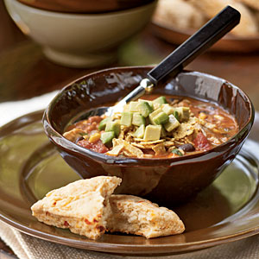
Reheating or Cooking Early
Refrigeration or freezing does not kill all harmful bacteria. Leftovers should be kept cold and reheated to 165°F.
If getting a head start on the holiday, turkey can be roasted early reheated for guests.
Debone turkey and quickly
and effectively chill meat.
Do not chill carcass whole.
Reheat to 165°F.

Slide 15
Panic Button Questions
The giblets were left inside and cooked in the turkey. Are the turkey and giblets safe?
A 20-pound turkey cooked overnight at 200°F and is ‘done’ at 7:30 AM. Can it be kept warm until 3 PM when the guests arrive?
The pumpkin pies have been sitting on the counter since I baked them last weekend. Are they still safe?

Slide 16
Recipes and Hotlines
www.holidayfoodsafety.org
www.cookinglight.com
www.allrecipes.com

Slide 17
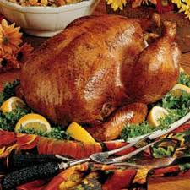
Resources
USDA:www.usda.gov/wps/portal/usda/usdahome
Search: Thanksgiving Holiday
www.holidayfoodsafety.org
A-Z index. T=Turkey
www.foodsafety.wisc.edu

Slide 18
Next Lunch & Learn
December 10 – Keep Food Safety in Mind at the Holidays
Whether you are hosting a party or sharing food-gifts with family and friends, there are some important food safety guidelines to keep in mind.
All slides and audio files are archived:
www.foodsafety.wisc.edu/preservation.html

